Slide 1
Zia’s Pizza App Design
Joaquín Martinez

Slide 2
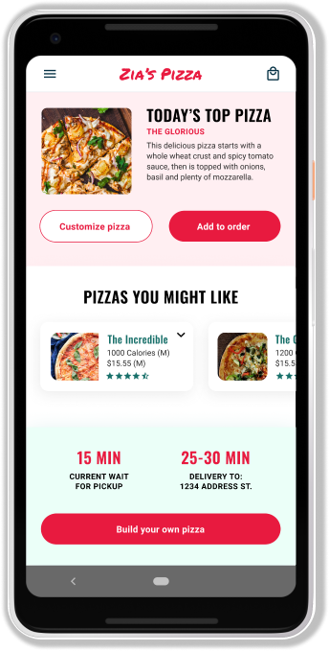
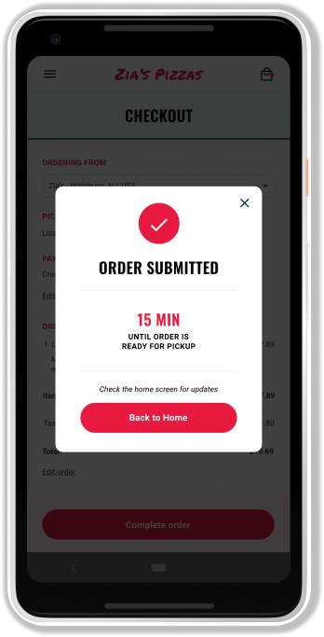
Project overview
The product:
Zia’s Pizza is a regional pizza maker located in the suburbs of a metropolitan area. Zia’s Pizza strives to deliver healthy, specialty pizzas and side dishes. They offer a wide spectrum of competitive pricing. Zia’s Pizza targets customers like commuters and workers who lack the time or ability to prepare a family dinner.
Project duration:
October 2020 to February 2021.

Slide 3
Project overview
The problem:
Busy workers and commuters lack the time necessary to prepare a meal.
The goal:
Design an app for Zia’s Pizza that allows users to easily order and pick up fresh, healthy dishes.

Slide 4
Project overview
My role:
UX designer designing an app for Zia’s Pizza from conception to delivery.
Responsibilities:
Conducting interviews, paper and digital wireframing, low and high-fidelity prototyping, conducting usability studies, accounting for accessibility, and iterating on designs.

Slide 5
Understanding
the user
User research
Personas
Problem statements
User journey maps

Slide 6
User research: summary
I conducted interviews and created empathy maps to understand the users I’m designing for and their needs. A primary user group identified through research was working adults who don’t have time to cook meals.
This user group confirmed initial assumptions about Zia’s Pizza customers, but research also revealed that time was not the only factor limiting users from cooking at home. Other user problems included obligations, interests, or challenges that make it difficult to get groceries for cooking or go to restaurants in-person.

Slide 7
User research: pain points
1
2
3
Time
Accessibility
IA
Working adults are too busy to spend time on meal prep
Platforms for ordering food are not equipped with assistive technologies
Text-heavy menus in apps are often difficult to read and order from

Slide 8
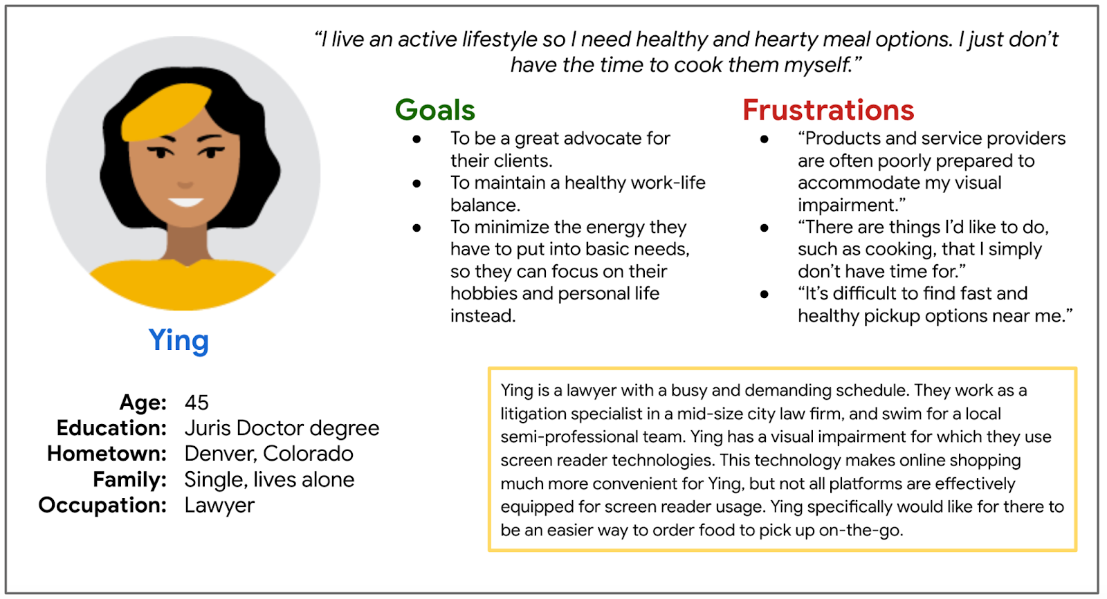
Persona: Ying
Problem statement:
Ying is a busy working adult who needs easy access to healthy food ordering options because they have no time to cook dinner for themself.

Slide 9
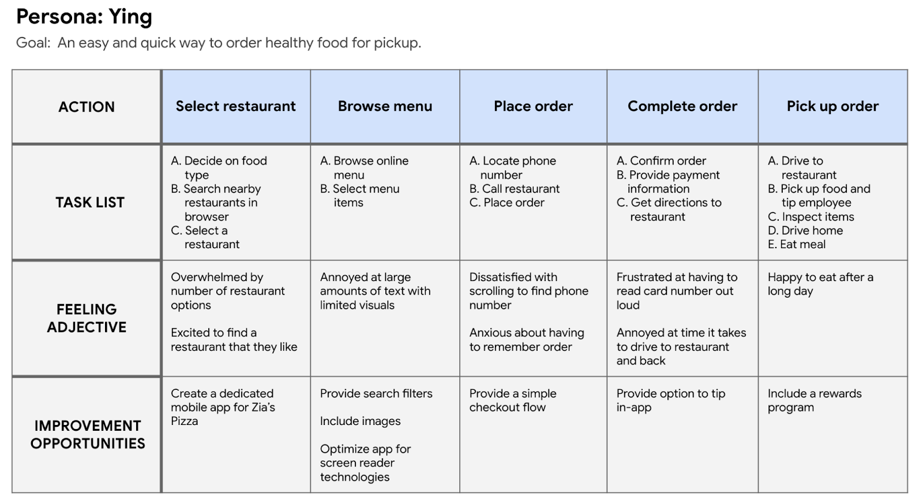
User journey map
Mapping Ying’s user journey revealed how helpful it would be for users to have access to a dedicated Zia’s Pizza app.

Slide 10
Starting
the design
Paper wireframes
Digital wireframes
Low-fidelity prototype
Usability studies

Slide 11
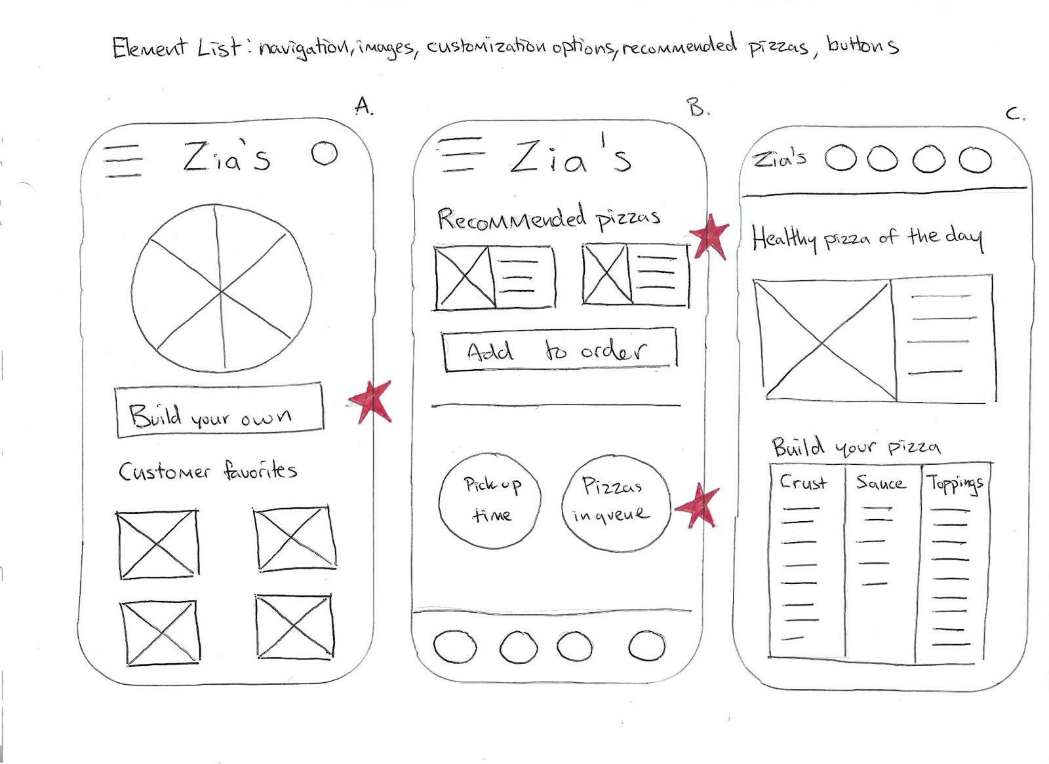
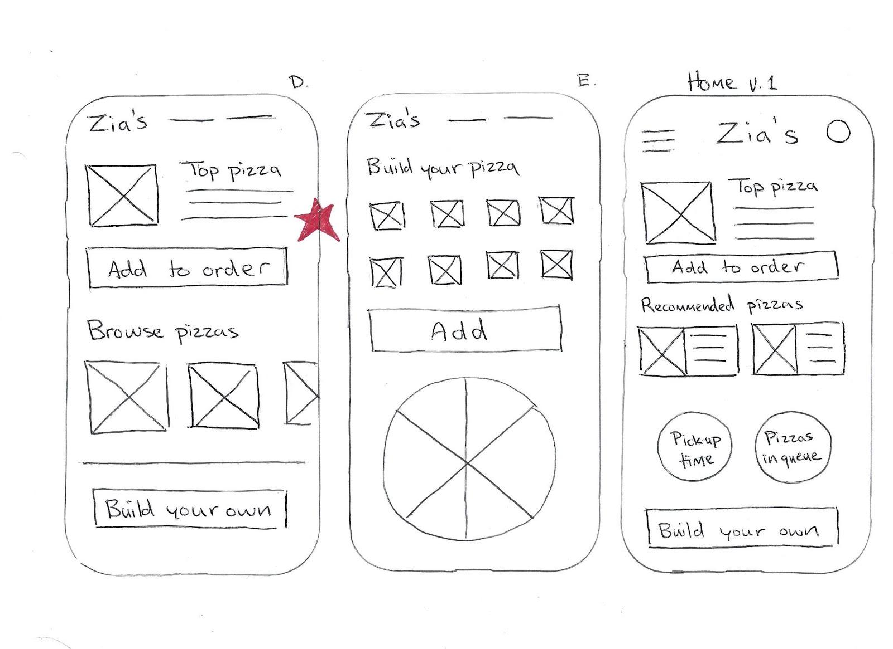
Paper wireframes
Taking the time to draft iterations of each screen of the app on paper ensured that the elements that made it to digital wireframes would be well-suited to address user pain points. For the home screen, I prioritized a quick and easy ordering process to help users save time.
Stars were used to mark the elements of each sketch that would be used in the initial digital wireframes.

Slide 12
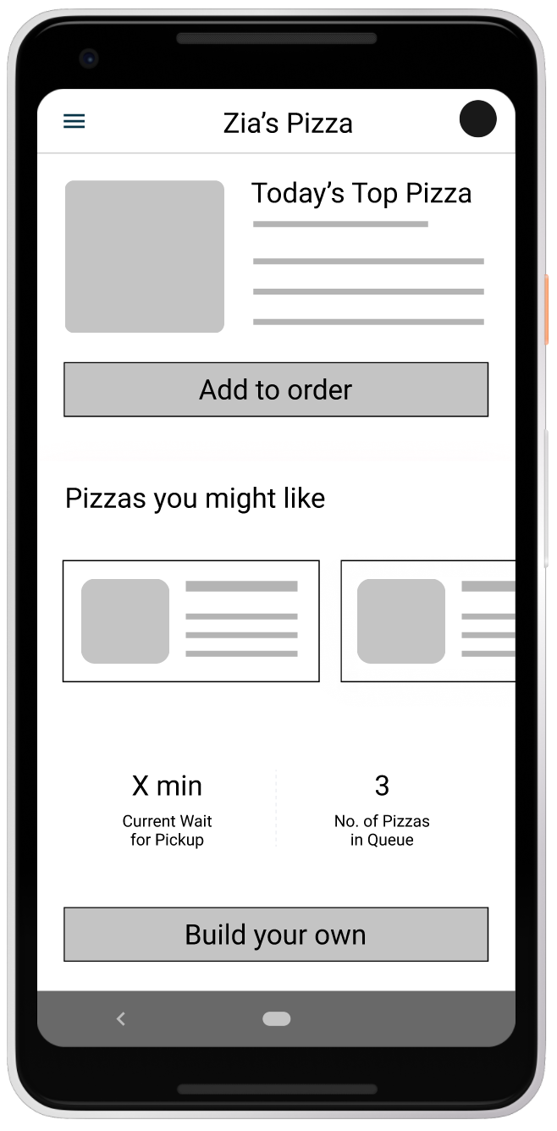
Digital wireframes
As the initial design phase continued, I made sure to base screen designs on feedback and findings from the user research.
This button at the top of the home screen makes it fast and easy for users to order.
This button provides an easy option for users to make their own pizza.

Slide 13
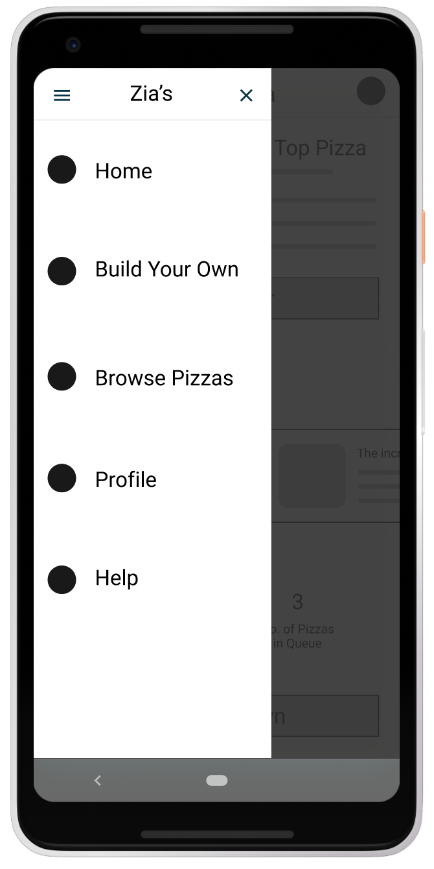
Digital wireframes
Easy access to navigation that’s screen reader friendly.
Easy navigation was a key user need to address in the designs in addition to equipping the app to work with assistive technologies.

Slide 14
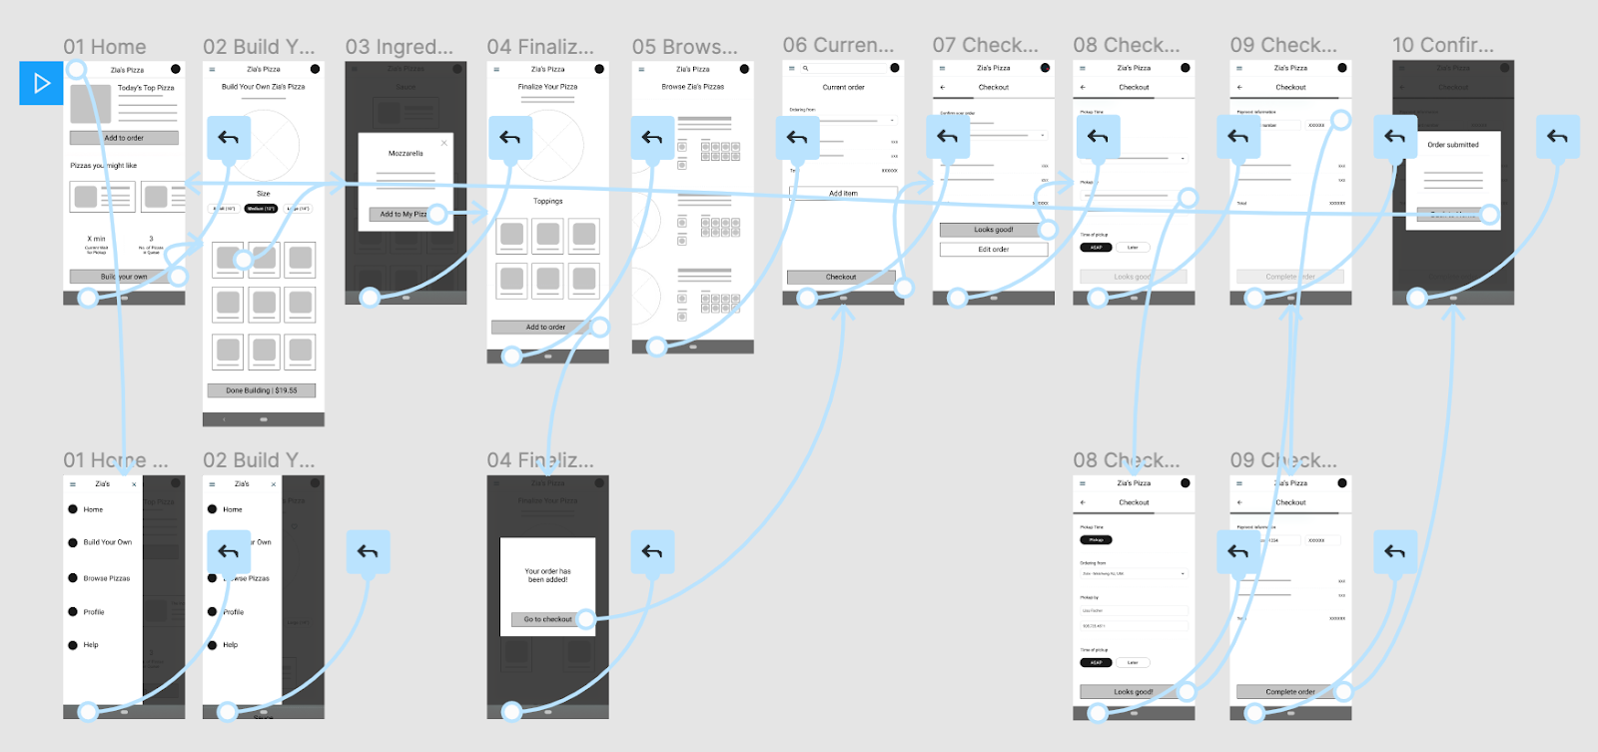
Low-fidelity prototype
Using the completed set of digital wireframes, I created a low-fidelity prototype. The primary user flow I connected was building and ordering a pizza, so the prototype could be used in a usability study.
View the Zia's Pizza low-fidelity prototype

Slide 15
Usability study: findings
I conducted two rounds of usability studies. Findings from the first study helped guide the designs from wireframes to mockups. The second study used a high-fidelity prototype and revealed what aspects of the mockups needed refining.
Round 1 findings
Round 2 findings
1
Users want to order pizza quickly
1
User confusion on using the app
2
Users wants app support
2
Users need customizable settings
3
Users want multiple stock entries

Slide 16
Refining
the design
Mockups
High-fidelity prototype
Accessibility

Slide 17
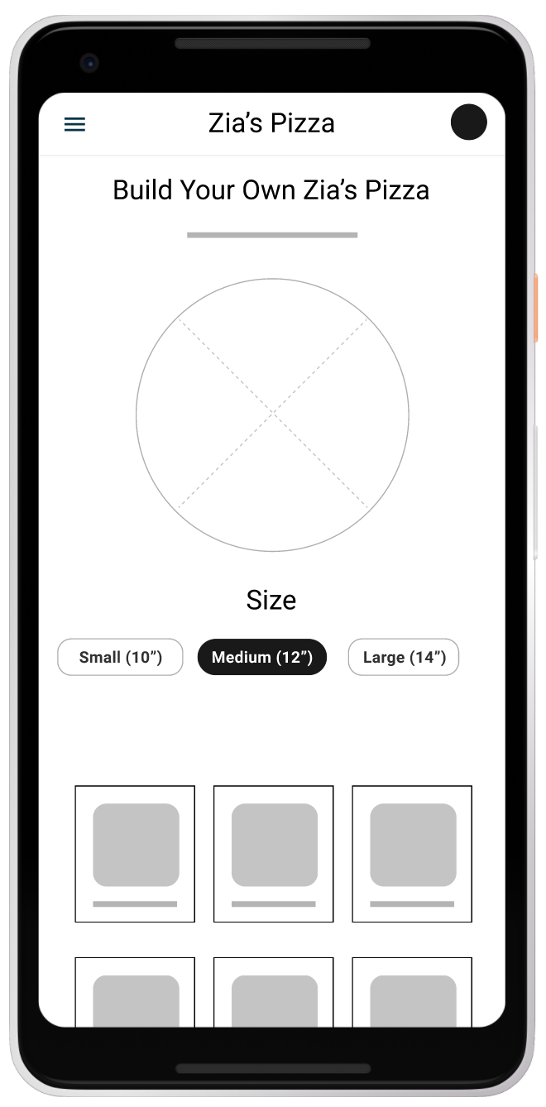
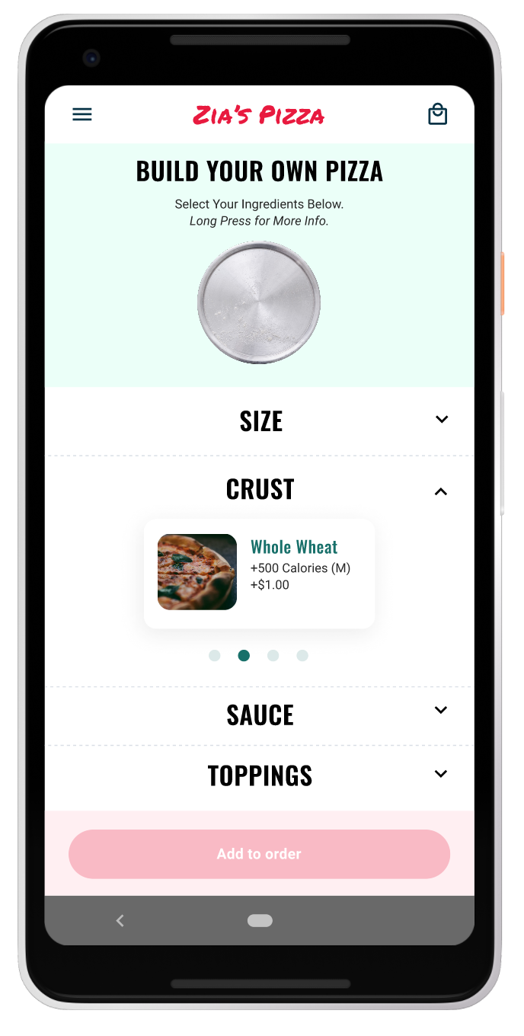
Mockups
Before usability studies
After usability studies
Early designs allowed for some customization, but after the usability studies, I added additional options to choose pizza crust and sauce. I also revised the design so users see all the customization options when they first land on the screen.

Slide 18
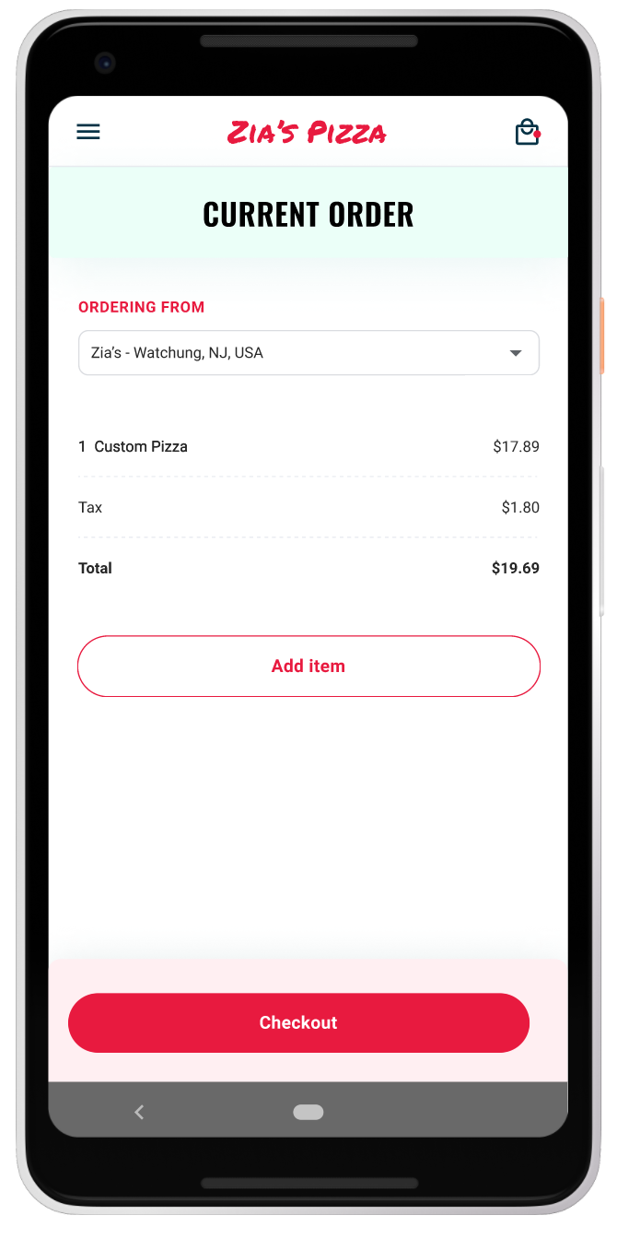
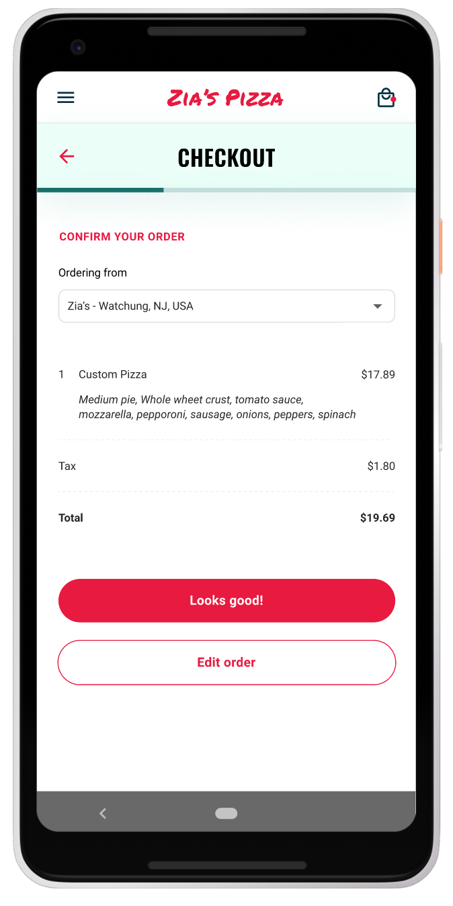
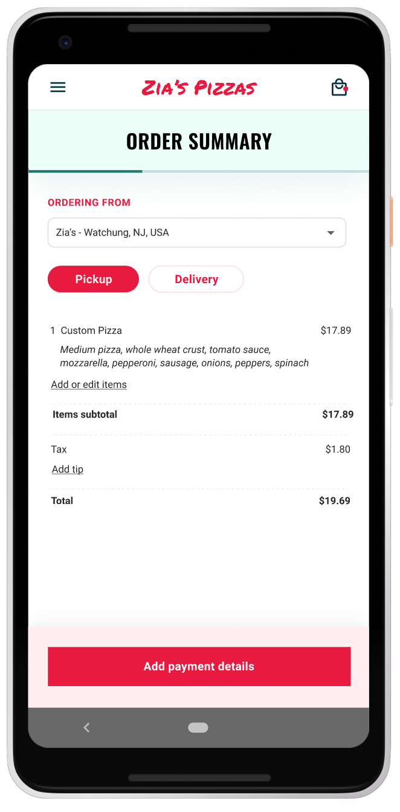
Mockups
Before usability study 2
After usability study 2
The second usability study revealed frustration with the checkout flow. to streamline this flow, I consolidated the “Current order” and “Checkout screens” to one “Order summary” screen.
I also added the pickup or delivery option to this screen.

Slide 19
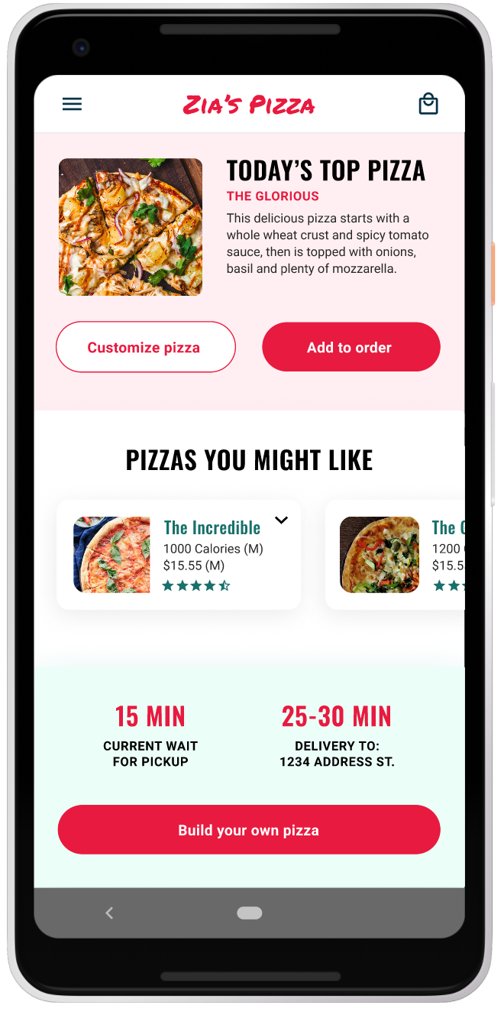
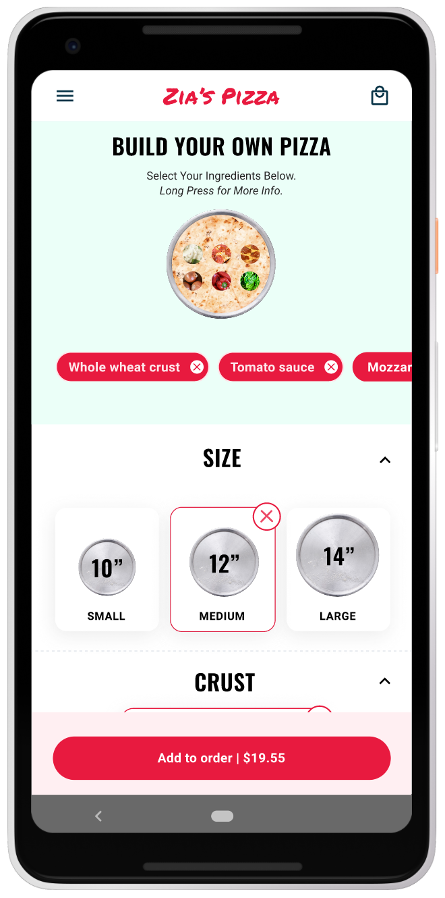
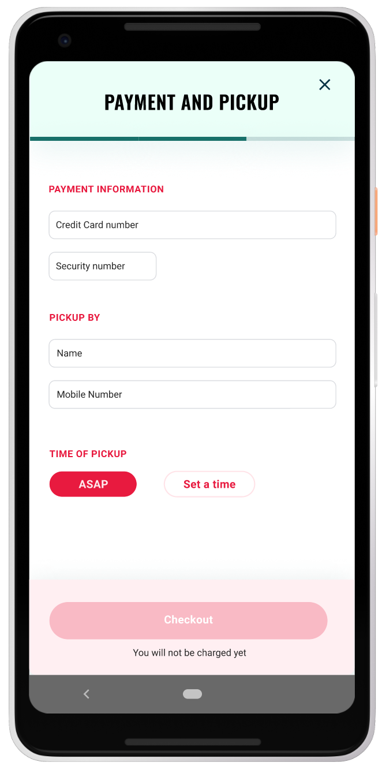
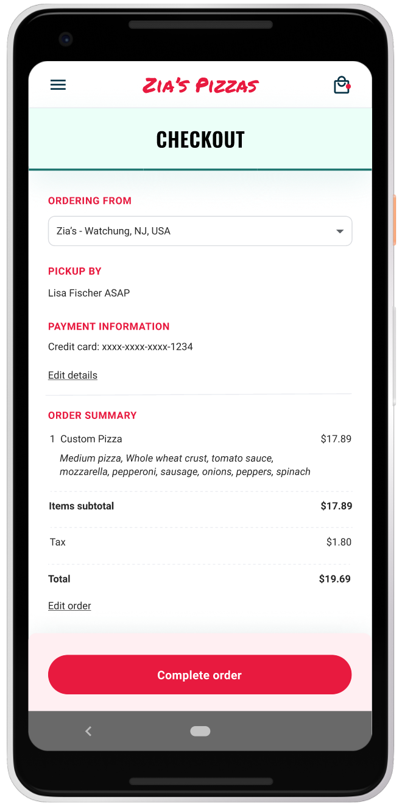
Key mockups

Slide 20
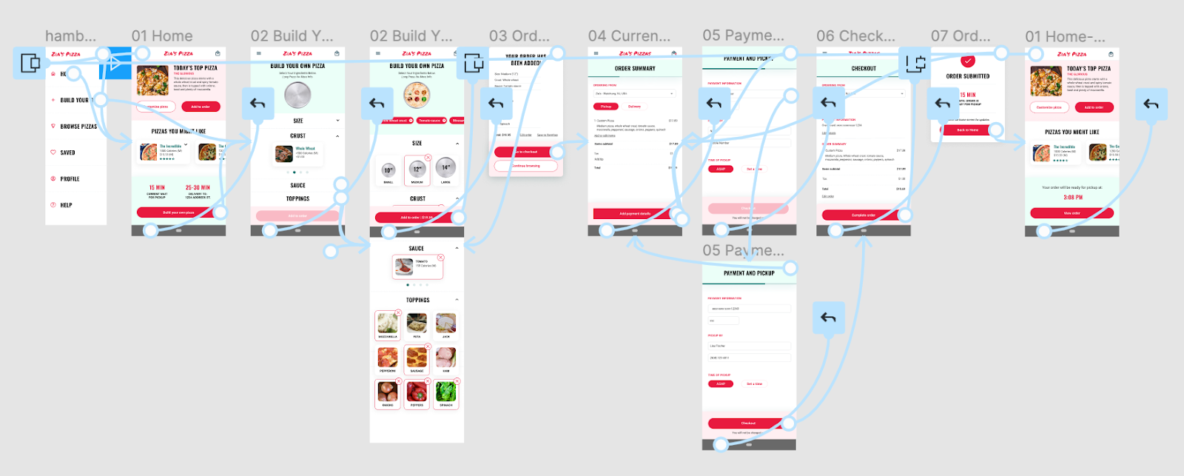
High-fidelity prototype
The final high-fidelity prototype presented cleaner user flows for building a pizza and checkout. It also met user needs for a pickup or delivery option as well as more customization.
View the Zia’s Pizza high-fidelity prototype

Slide 21
Accessibility considerations
1
2
3
Provided access to users who are vision impaired through adding alt text to images for screen readers.
Used icons to help make navigation easier.
Used detailed imagery for pizzas and toppings to help all users better understand the designs.

Slide 22
Going forward
Takeaways
Next steps

Slide 23
Takeaways
Impact:
The app makes users feel like Zia’s Pizza really thinks about how to meet their needs.
One quote from peer feedback:
“The app made it so easy and fun to build my own pizza! I would definitely use this app as a go-to for a delicious, fast, and even healthy meal.”
What I learned:
While designing the Zia’s Pizza app, I learned that the first ideas for the app are only the beginning of the process. Usability studies and peer feedback influenced each iteration of the app’s designs.

Slide 24
Next steps
1
2
Conduct another round of usability studies to validate whether the pain points users experienced have been effectively addressed.
Conduct more user research to determine any new areas of need.

Slide 25
Let’s connect!
Thank you for your time reviewing my work on the Zia’s Pizza app! If you’d like to see more or get in touch, my contact information is provided below.
Email: jmartinez@email.com
Website: jmartinezdesign.uxportfolio.com

Slide 26
Thank you!

